Slide 1

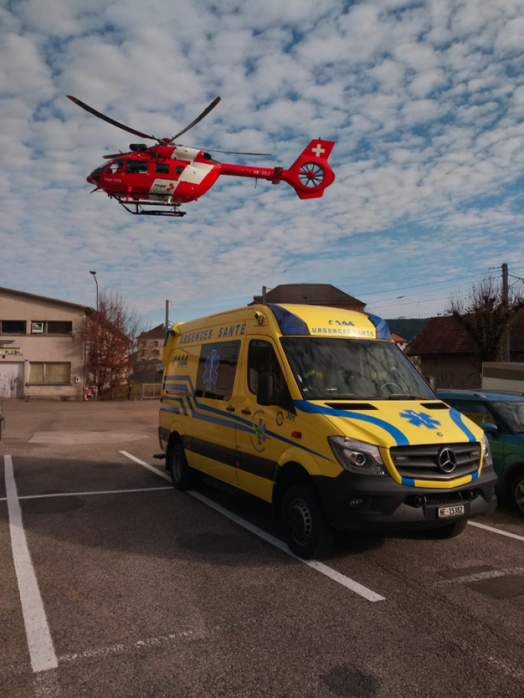
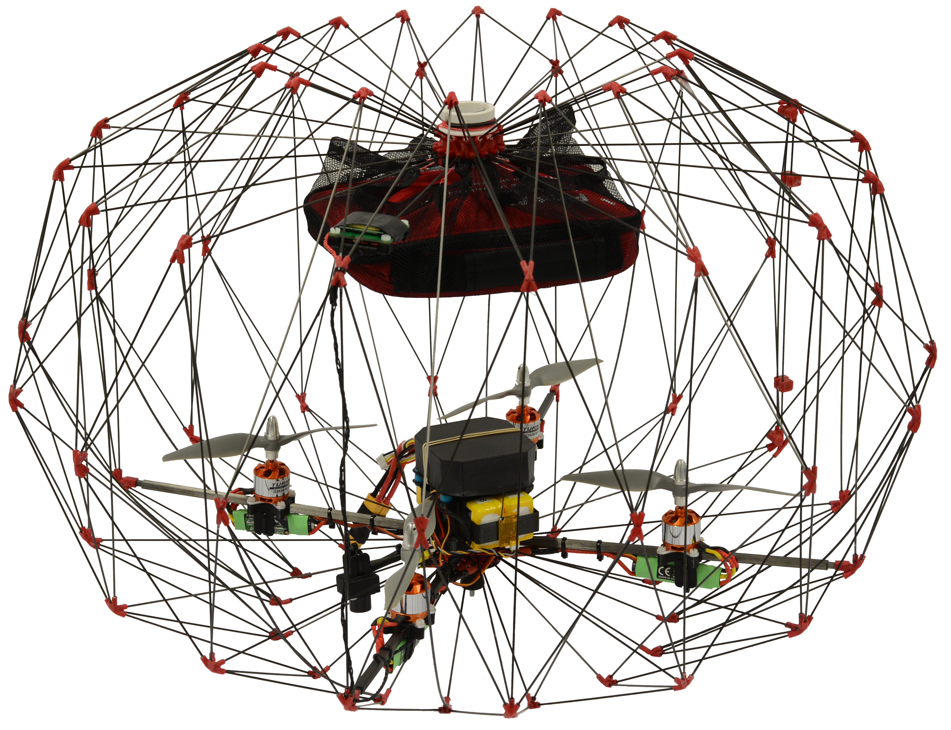
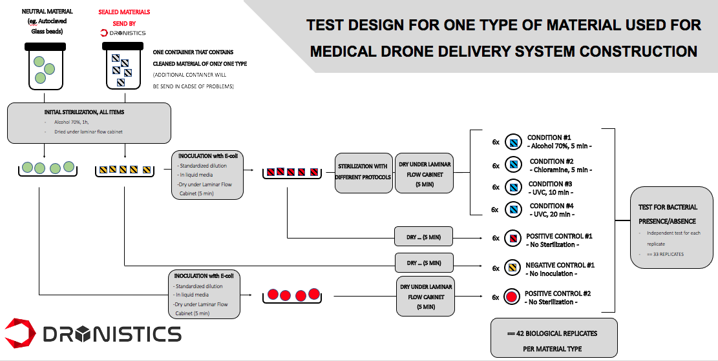
https://youtu.be/229nqnlYw5E
Project Manager @
Medical Delivery Drones
Experiment
Design
Project & Team Management
Data
Analysis
MY WORK
I led R&D team
@ King’s College London on adapting drone maintenance procedures to requirement from hospitals, & rescue services.

Slide 2

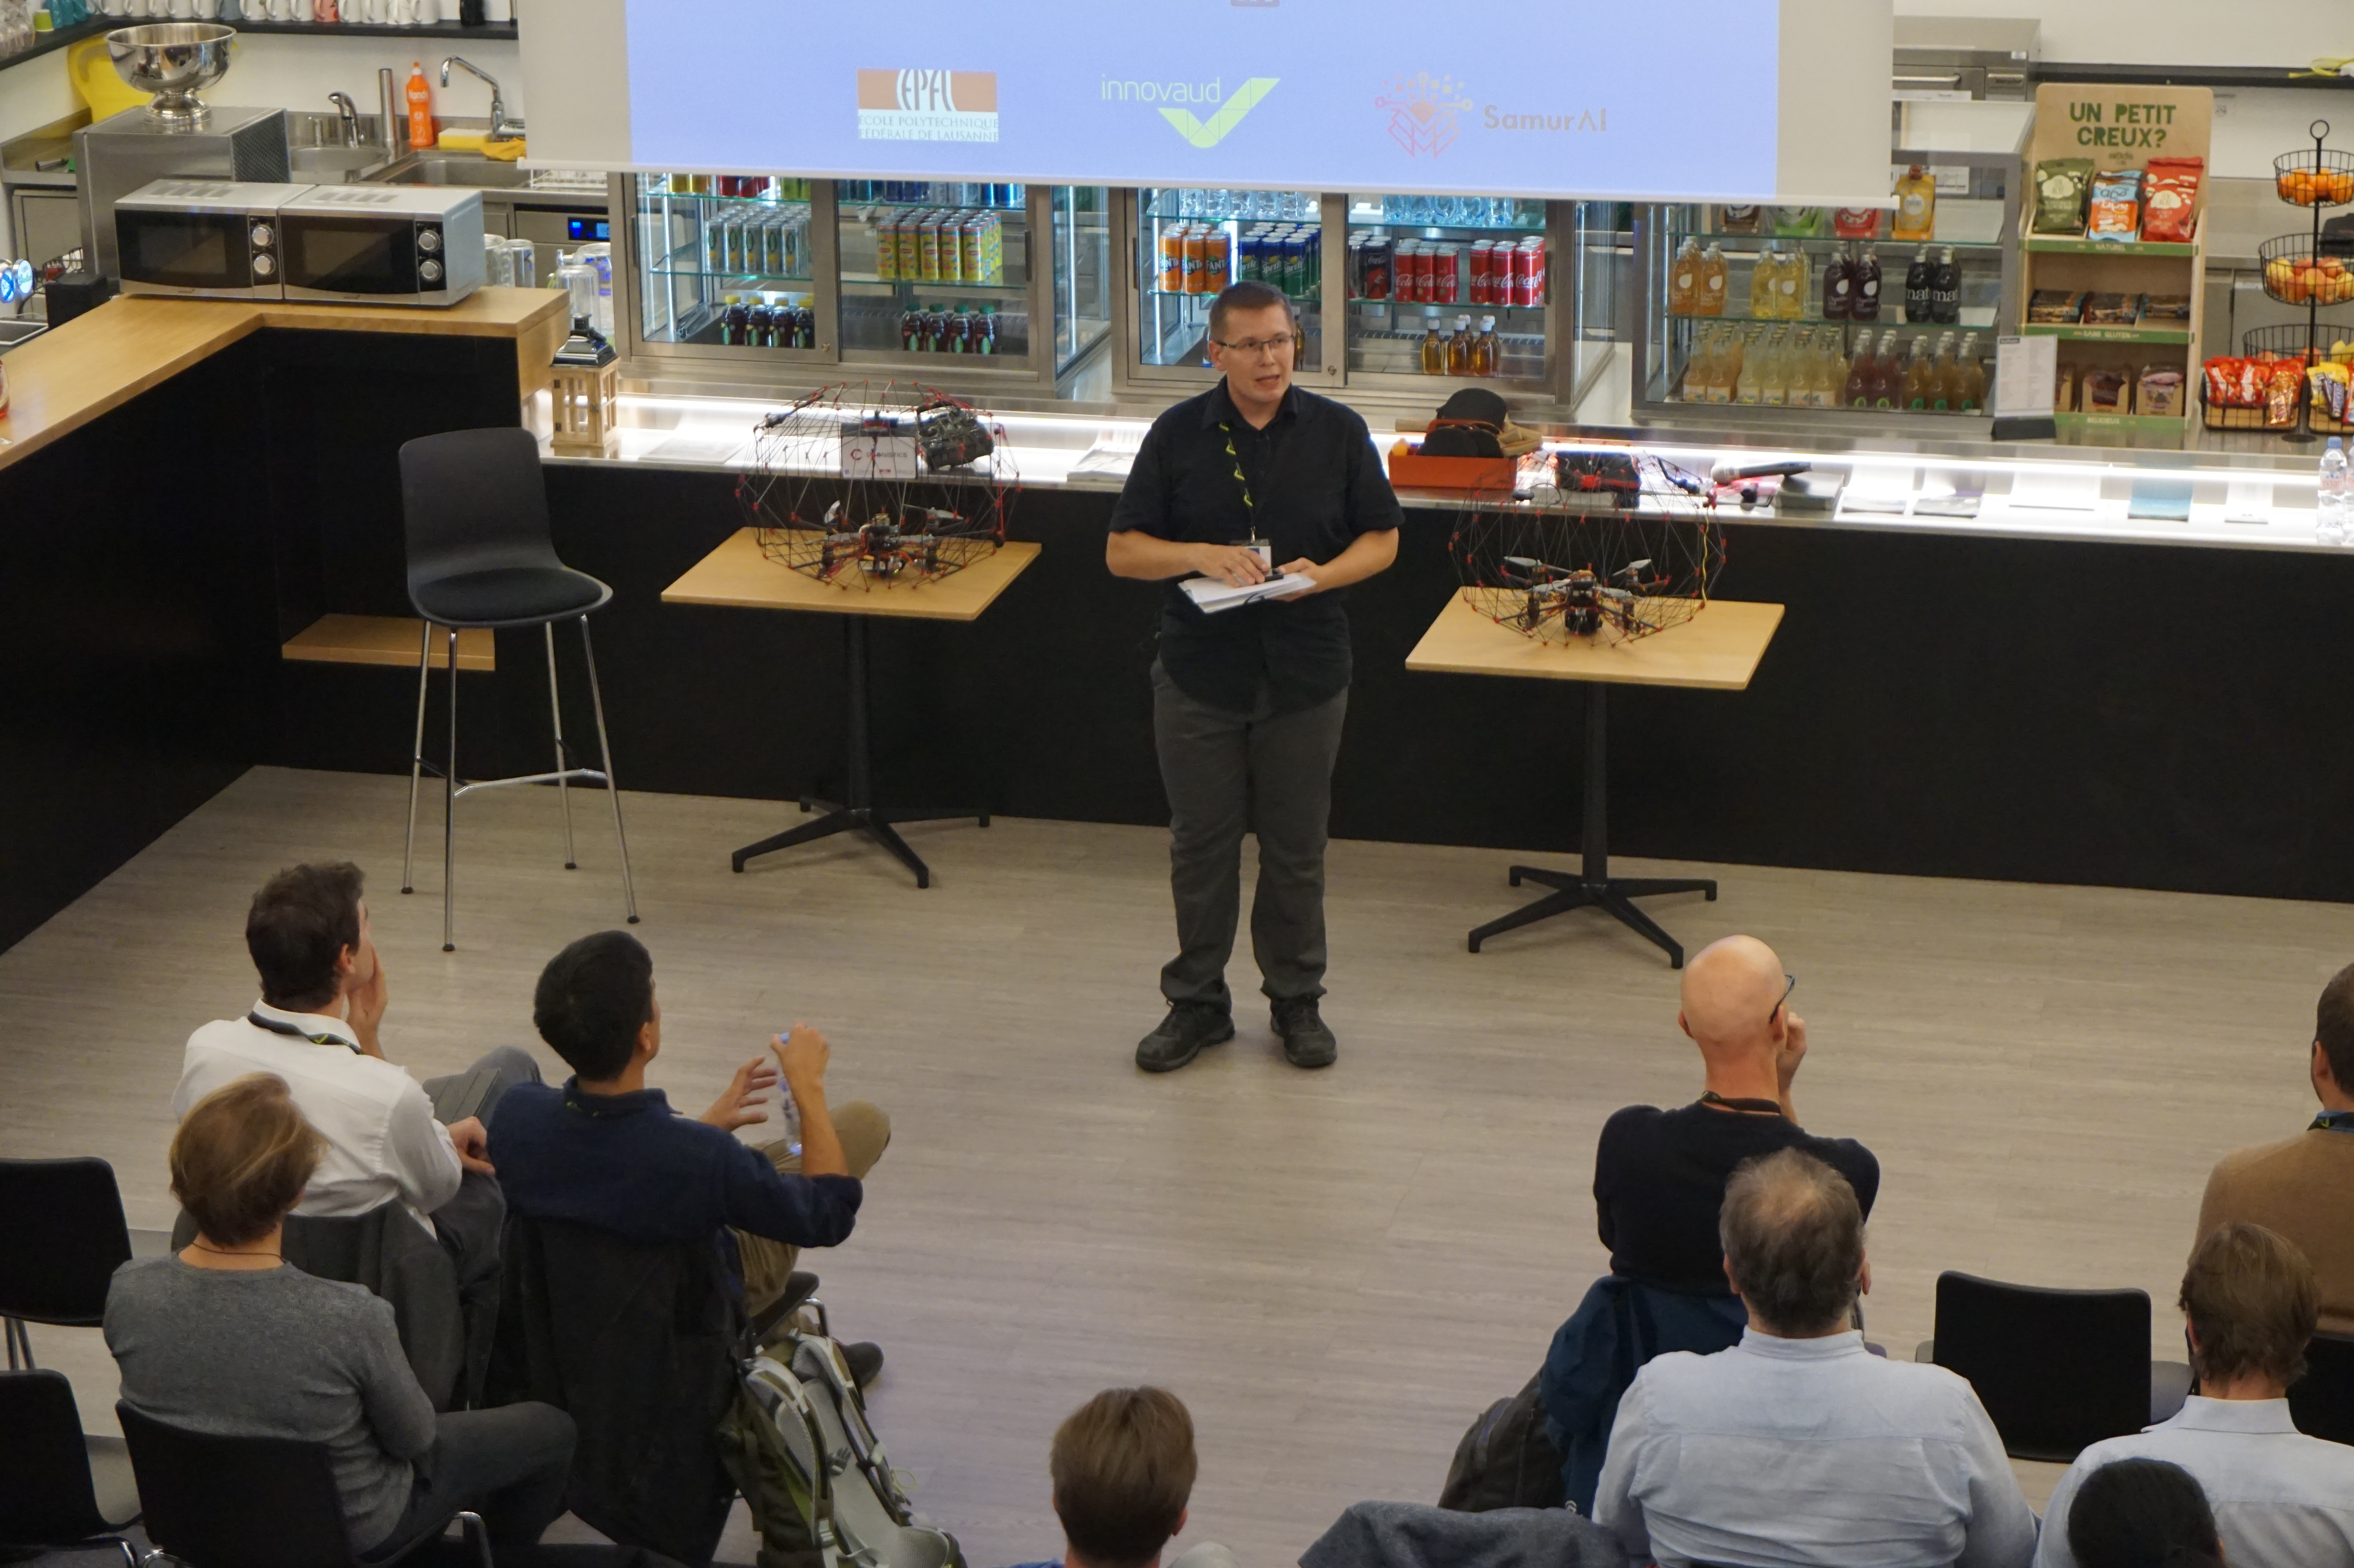
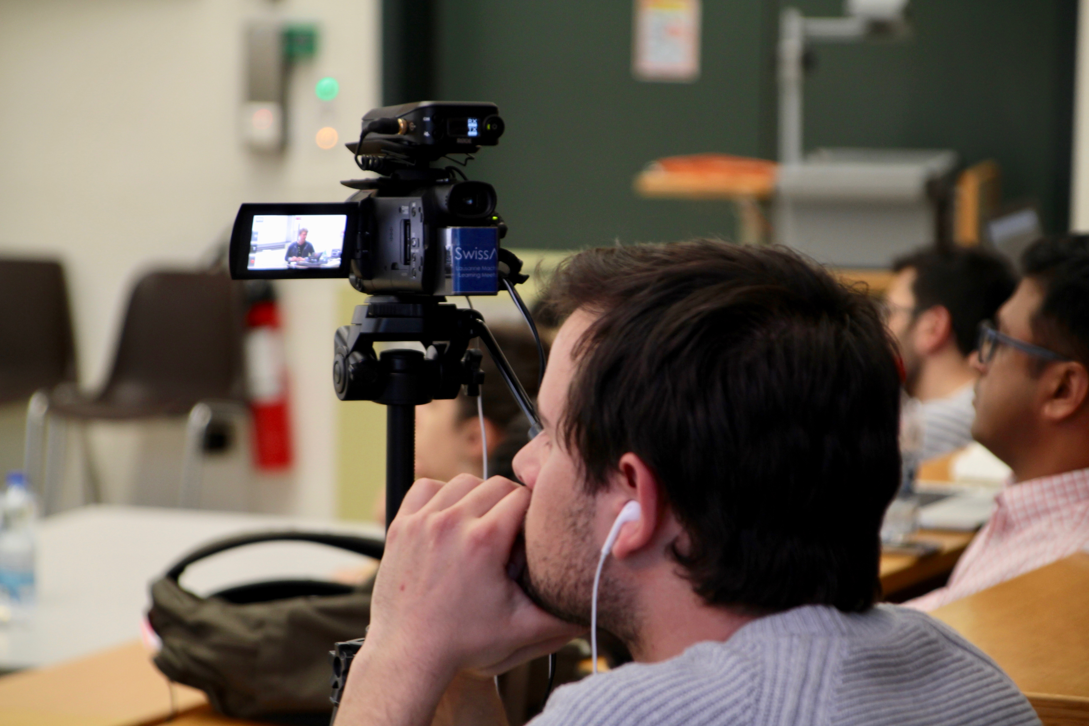
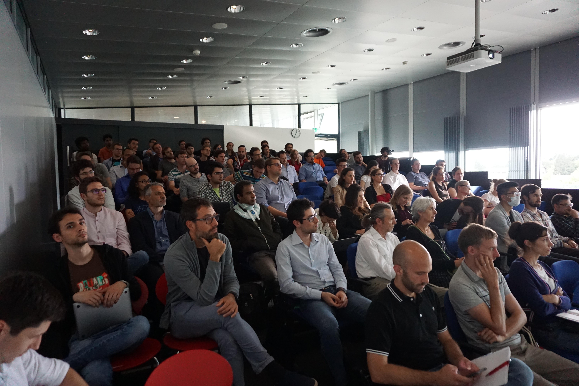
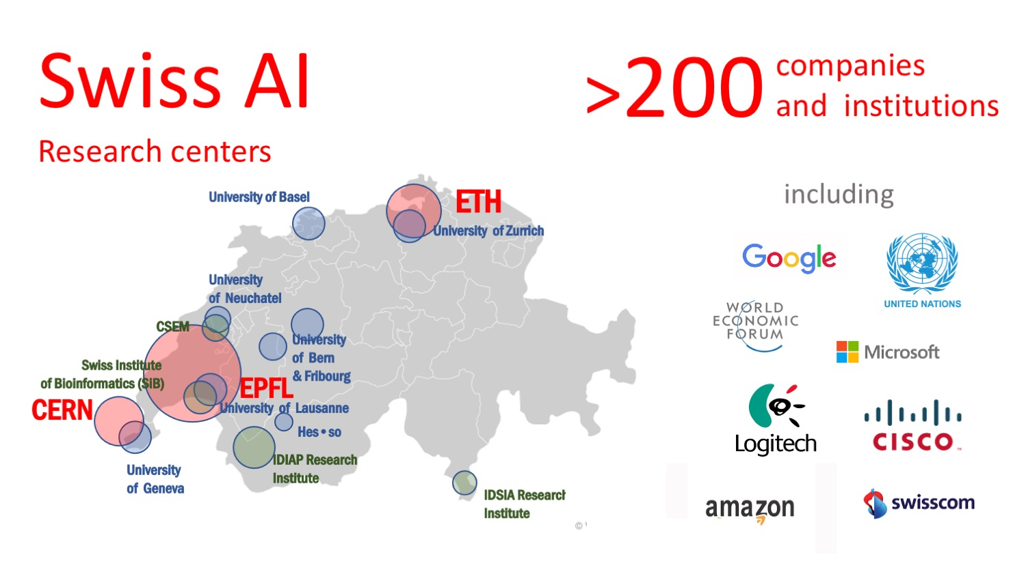
I created SwissAI
one of the largest AI communities in Europe
2500 MEMBERS
Meetups
Courses
Workshops
Interviews
Consulting
Mentoring
www.SwissAI.org

Slide 3

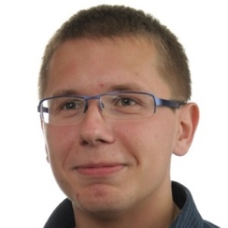
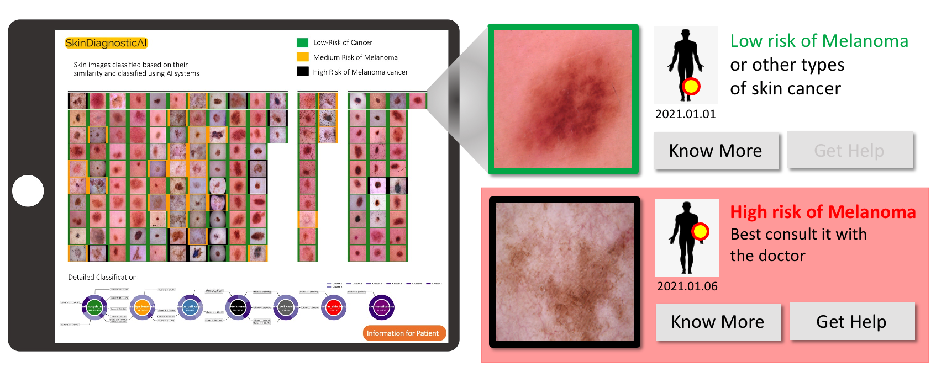
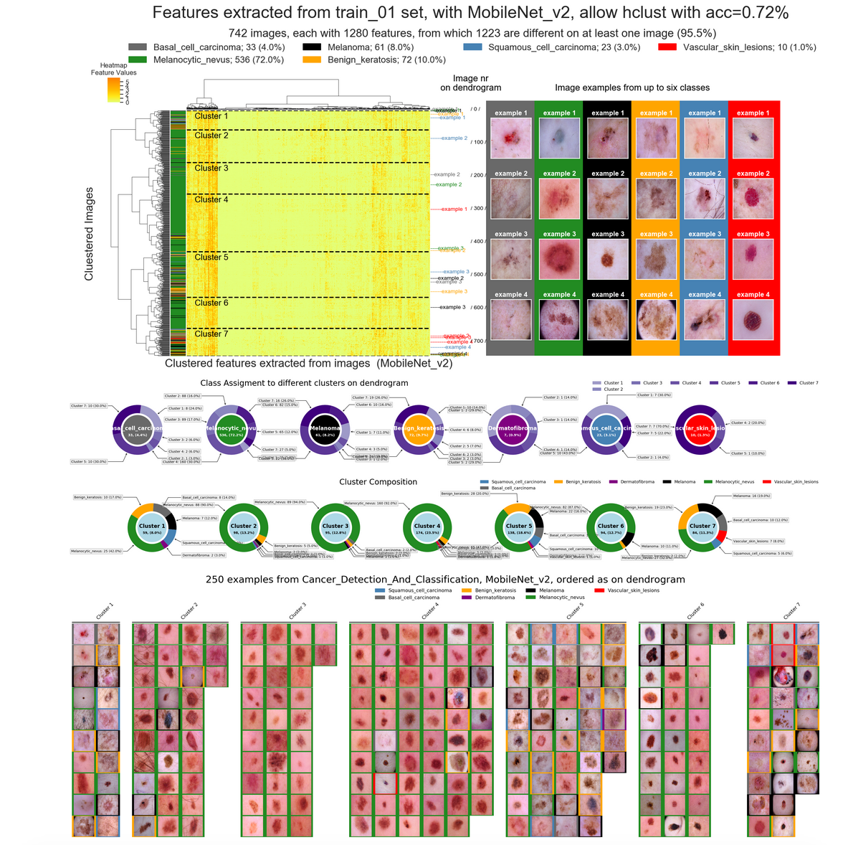
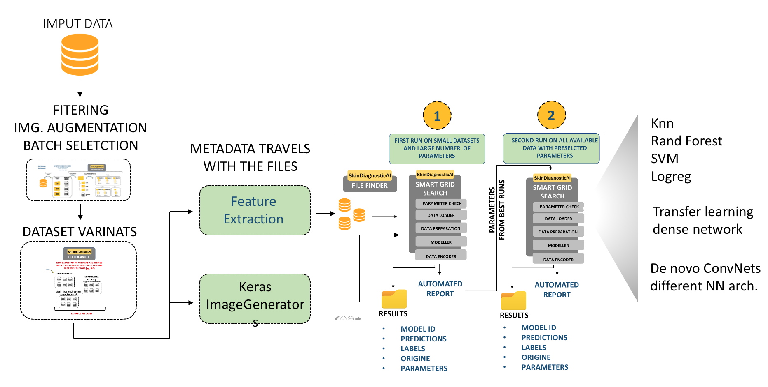
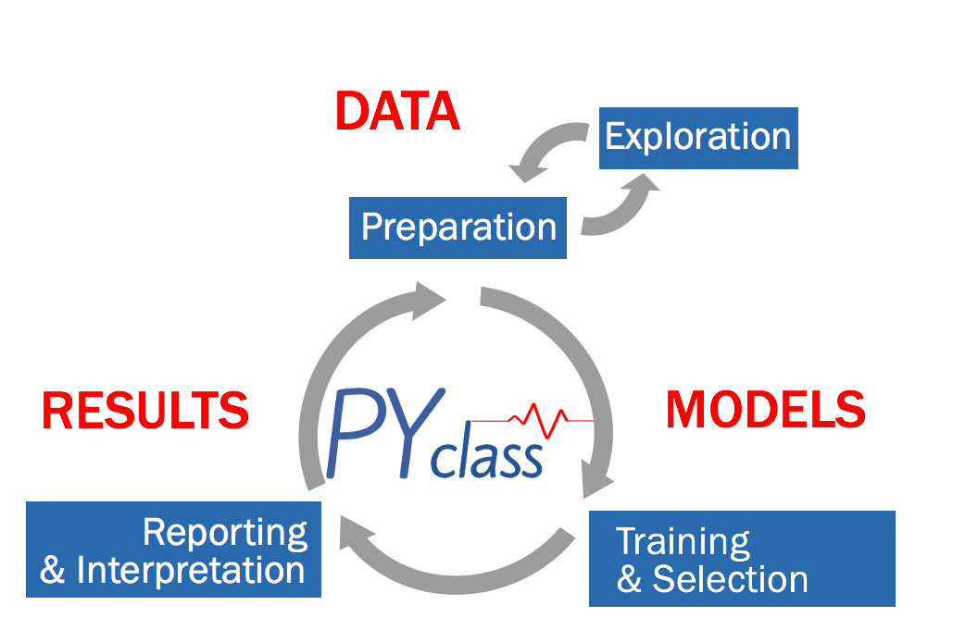

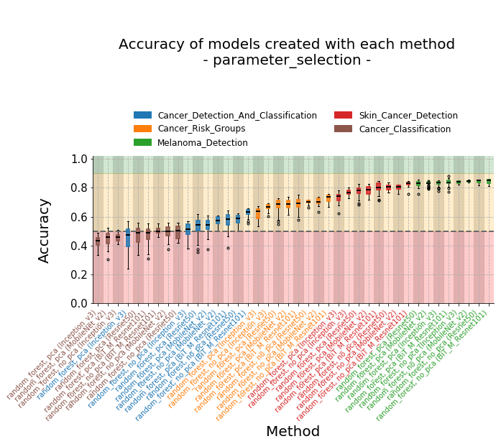
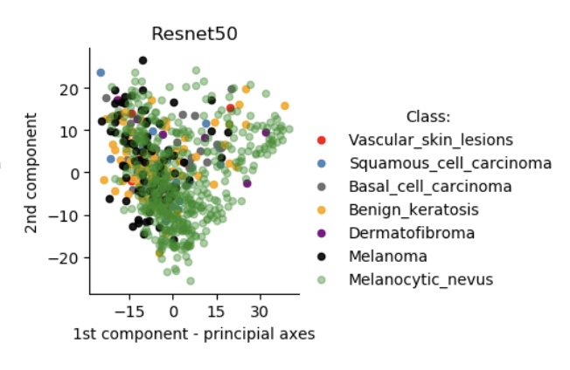
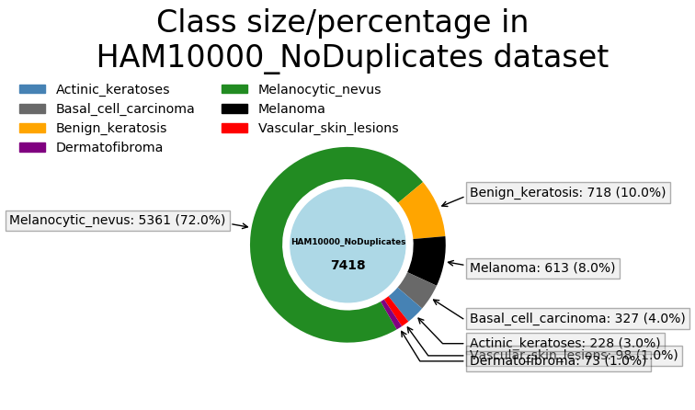
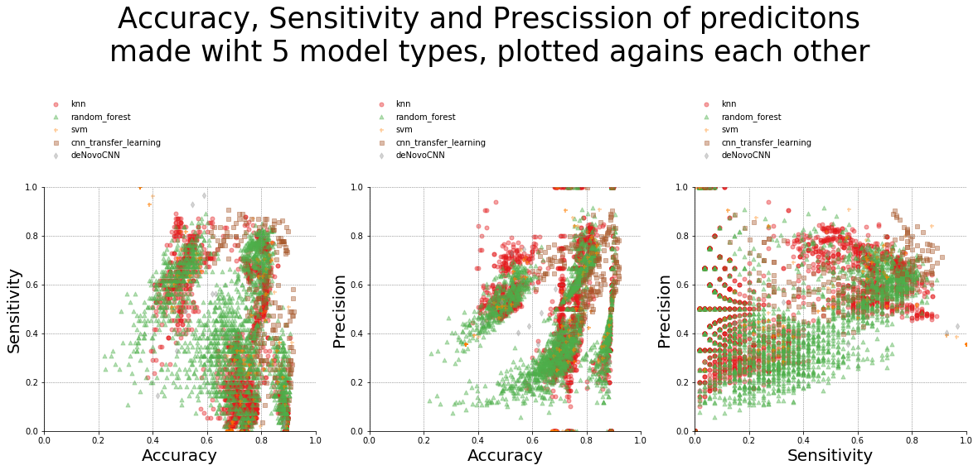
Product Owner & Lead Data Scientist
Pawel Rosikiewicz
Responsible for
Early Detection of Skin Cancer with Low-cost Devices
project vision
product dev.
Team of 3 Developers
& 11 Advisors
AI workbench for Analysis
of Medical Images
Created
Backbone of systems using medical images
Classification
of
Medical Images
Evaluated
Model Accuracy
5000+ Models
Several Datasets
nn
Diagnostic Purpose
Value Proposition
de-novo cnn
Business Model

Slide 4

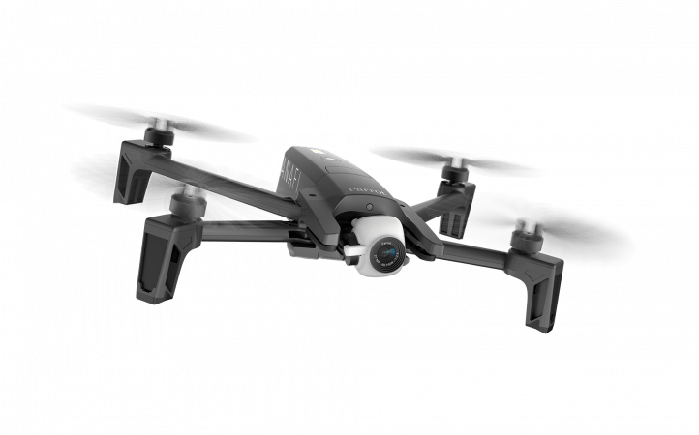




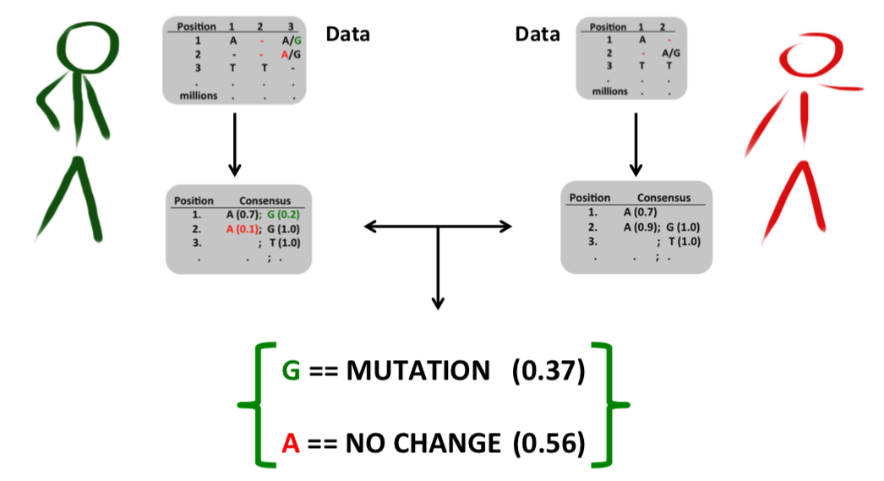




Product Owner & Lead Developer
Gap.Jumper
Pawel Rosikiewicz
Detection and quality evaluation
of genetic markers
THE PROBLEM
Even samples taken from the same source
may give different results
MY SOLUTION
Sequencing results for one position in three replicates
I implemented the approach that is used for decision making in drones & planes
A/T
A
na
OK
T – NOT DETECTED
NO DATA
SEMI-SUPERVIZED ML ALG.
DST-BASED
NO IMPUTATION
Evidence Scores
A/T
A
na
A
= 0.83
na
NEW POSIBILITIES FOR
Data Support
A
T
= 0.27
na
T
Using data from many sources
Selection of Genetic Markers
Support for other methods
Sample Quality
CREATED AS PRODUCT
Control Group
Patient
Extensive manual & tutorial
Promoted it in a community
Prepared to deploy in private company
www.SimpleAI.ch
based only on empirical data
& samples quality

Slide 5







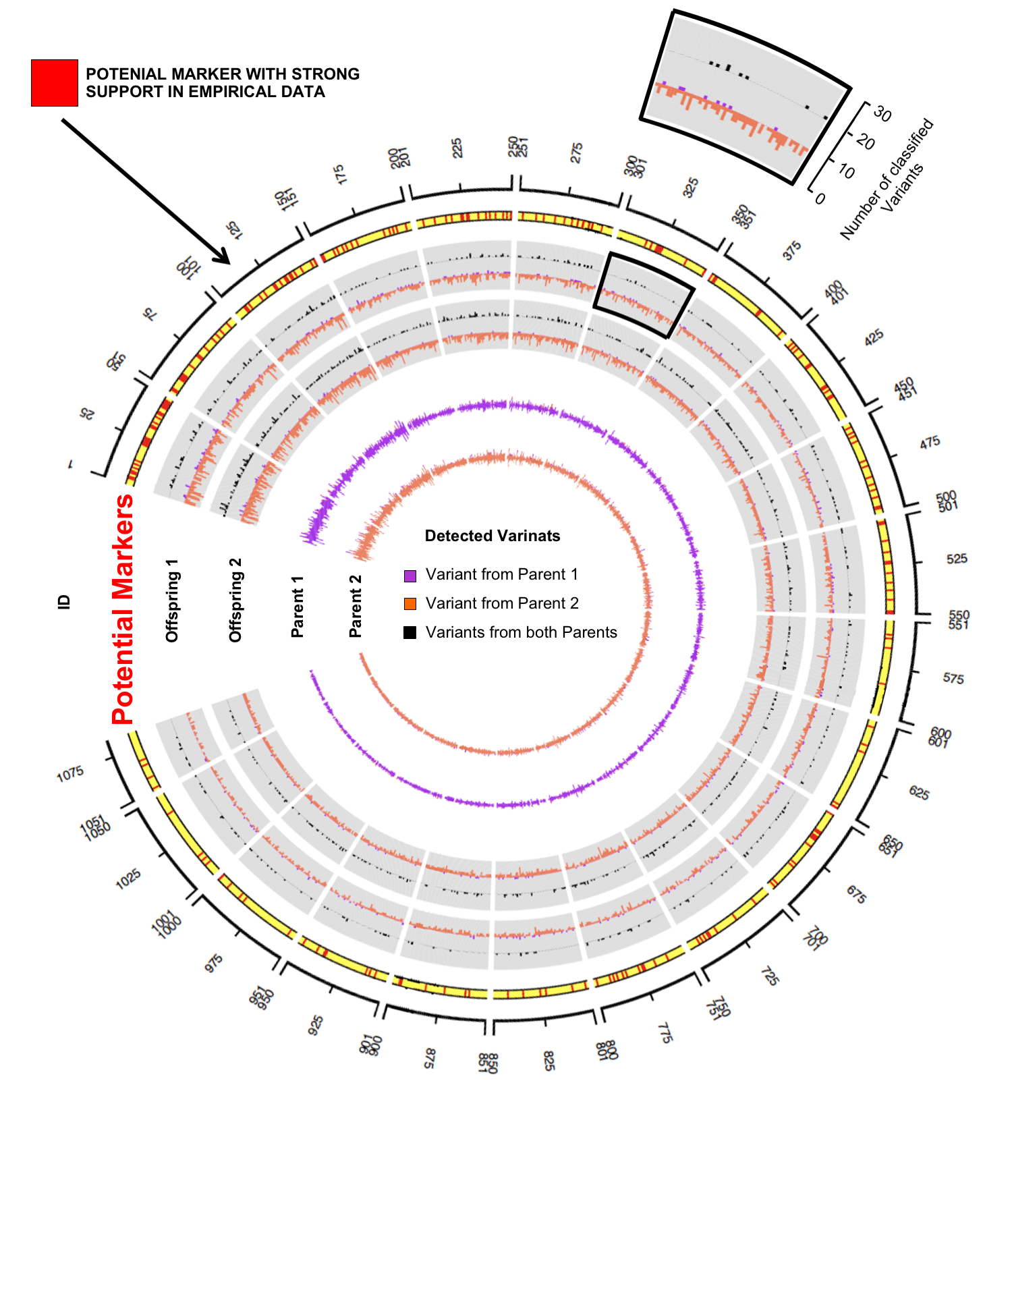
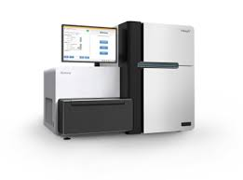
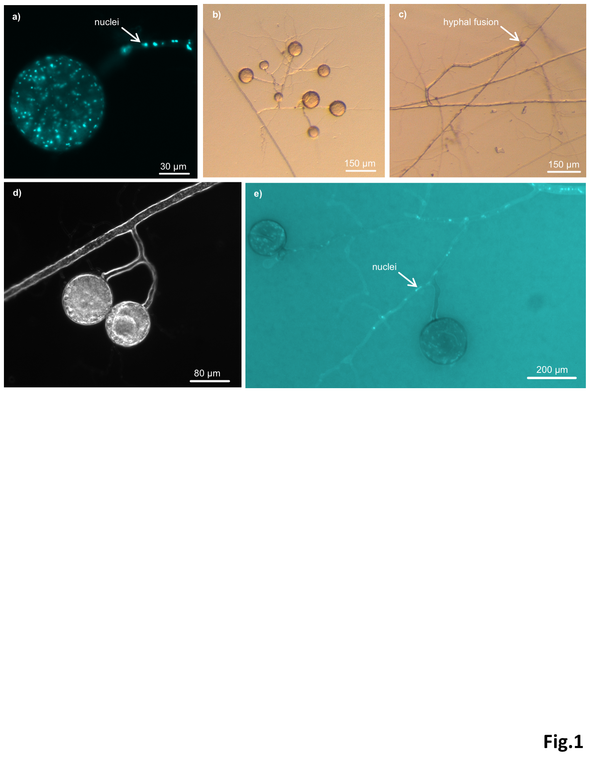
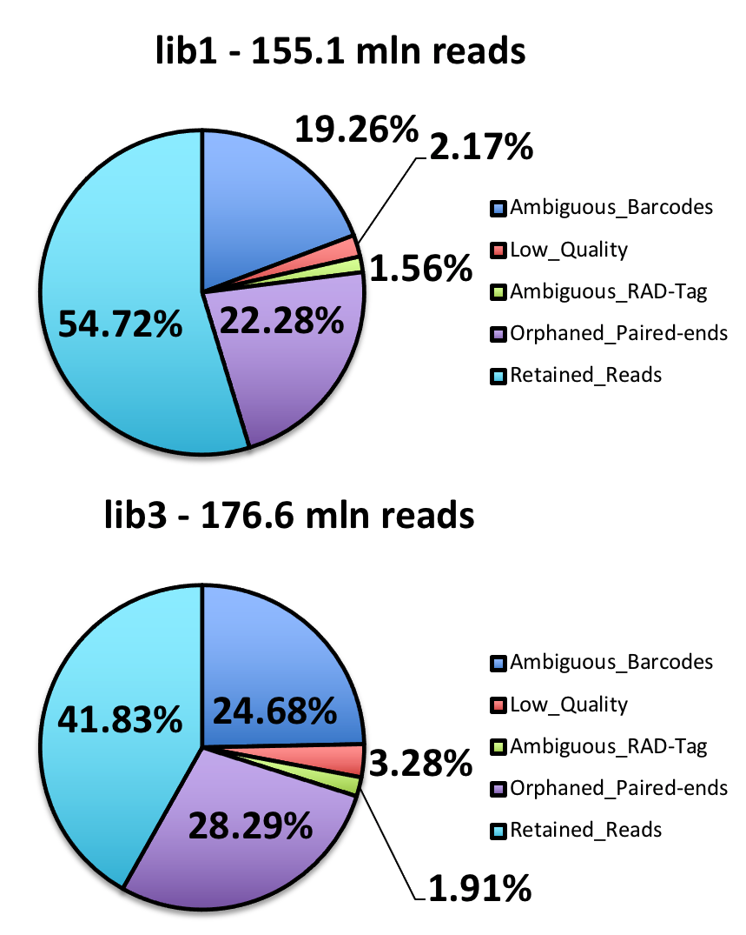
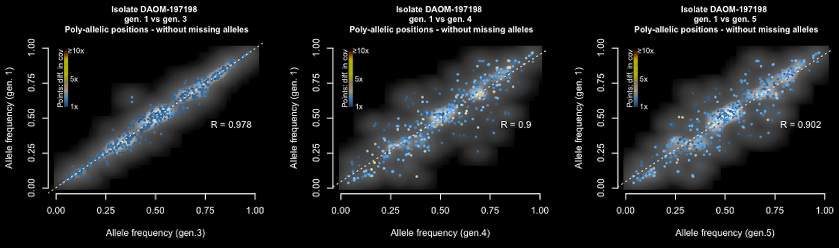
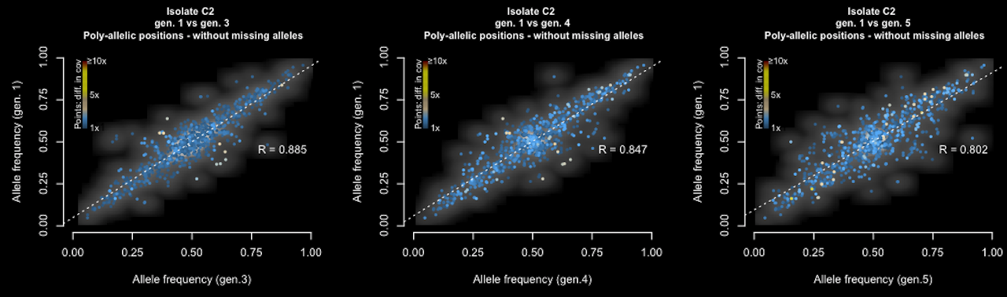
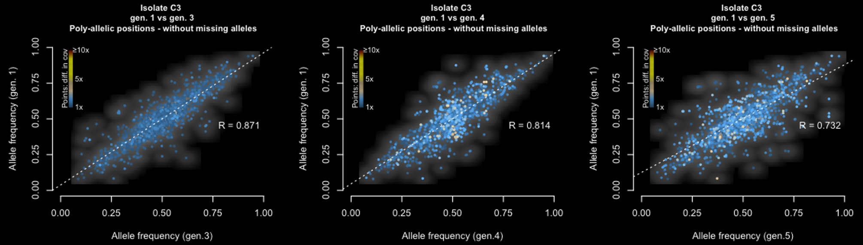
Pawel Rosikiewicz
Lead Researcher in multi-stage project
Created Entire System for production & identification
of microorganisms used as biofertilizers
LABOLATORY
MOLECULAR BIOLOGY
& BIOINFORMATICS
DATA ANALYSIS
DESIGN
NGS SEQUENCING
GENETICS
MY ROLE
PROTOCOL DEV.
MANAGED LAB TEAM
PRIMARY ANALYSIS
CUSTOM PIPELINES
MY MAIN EXPERIMENT
Sequencing
I DEVELOPED
Took 5 years
>25.000 bio-samples
3TB or raw data
New Analytical
Methods
Dashboards
Visualizations
Pipelines
MY PROJECT
Variant Calling*
Quality Filtering
PRODUCTS GENERATED WITH MY PROJECT
IMAPCT
MY IN VITRO
CULTURE SYSTEM
NGS PROTOCOL
60 STRAINS
OF MICROORGANISMS
IMPLEMENTED IN INDUSTRY
USED OVER 6000x
TESTED FOR USE IN AGRONOMY

Slide 6
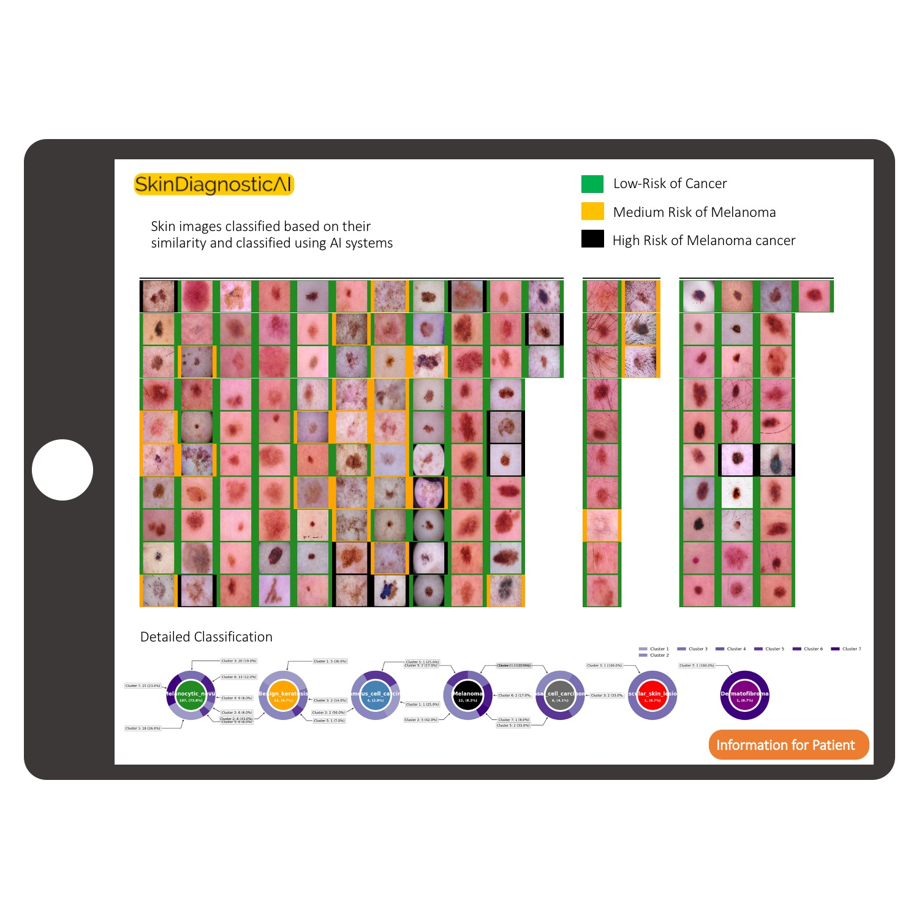
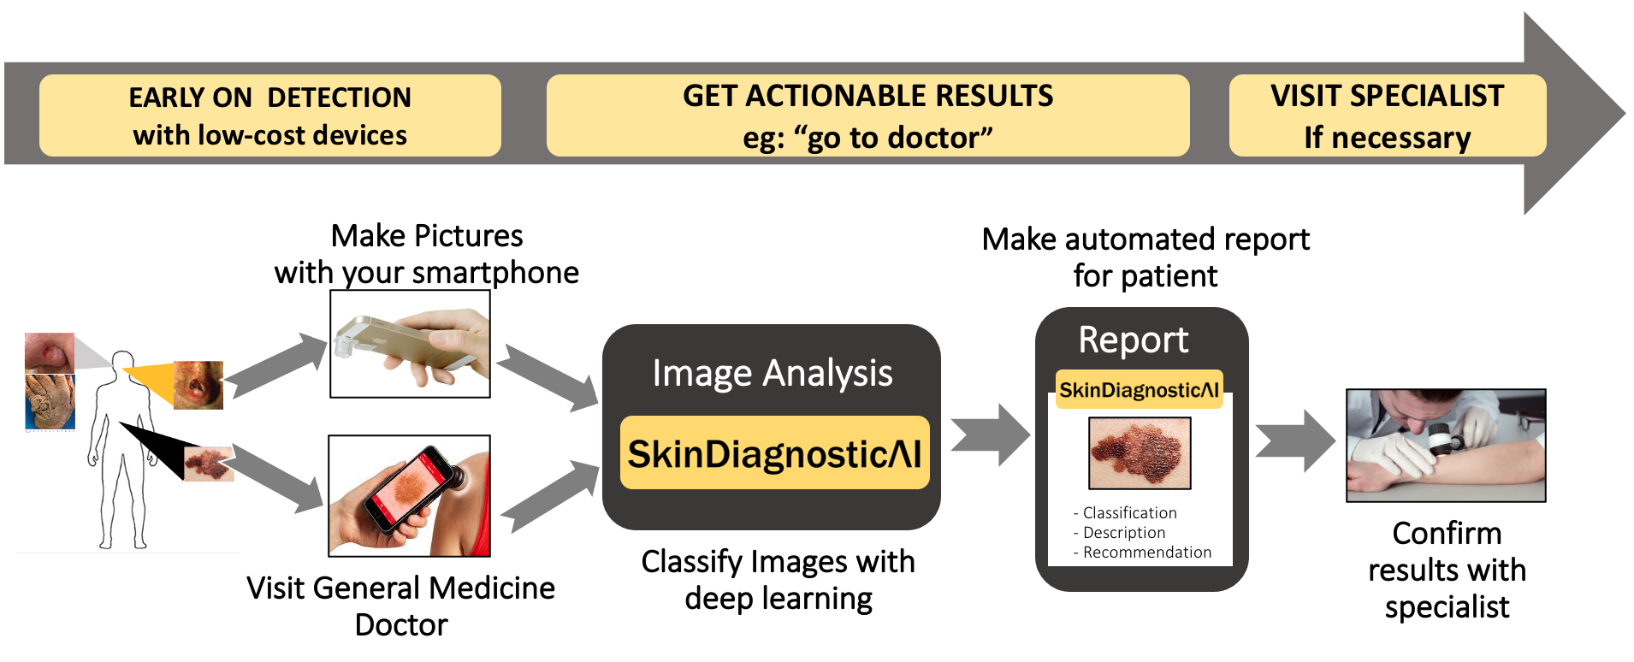
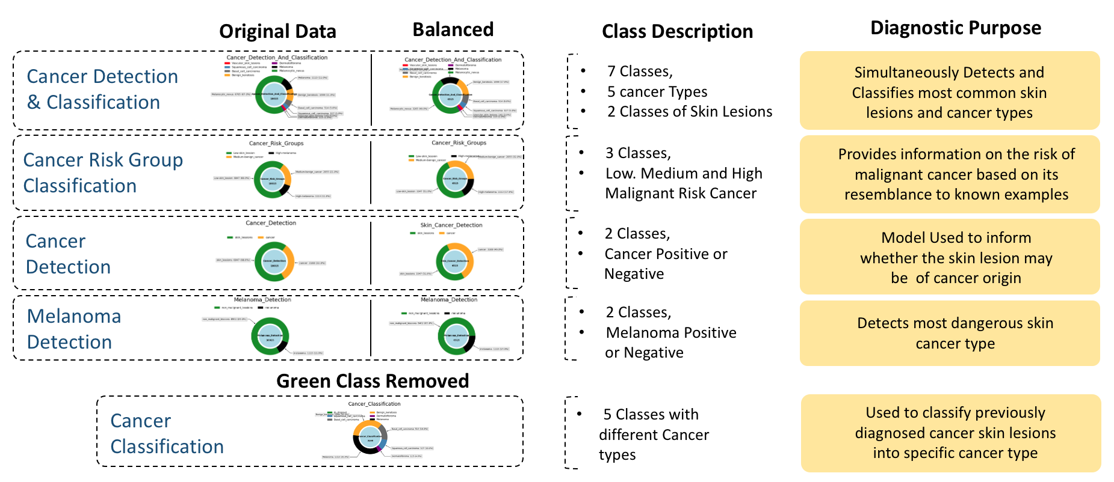
App for Skin Cancer Detection
with low-cost devices
PRODUCT IDEA
App for Skin Cancer Detection with low-cost devices
FEASIBILITY STUDY

Slide 7
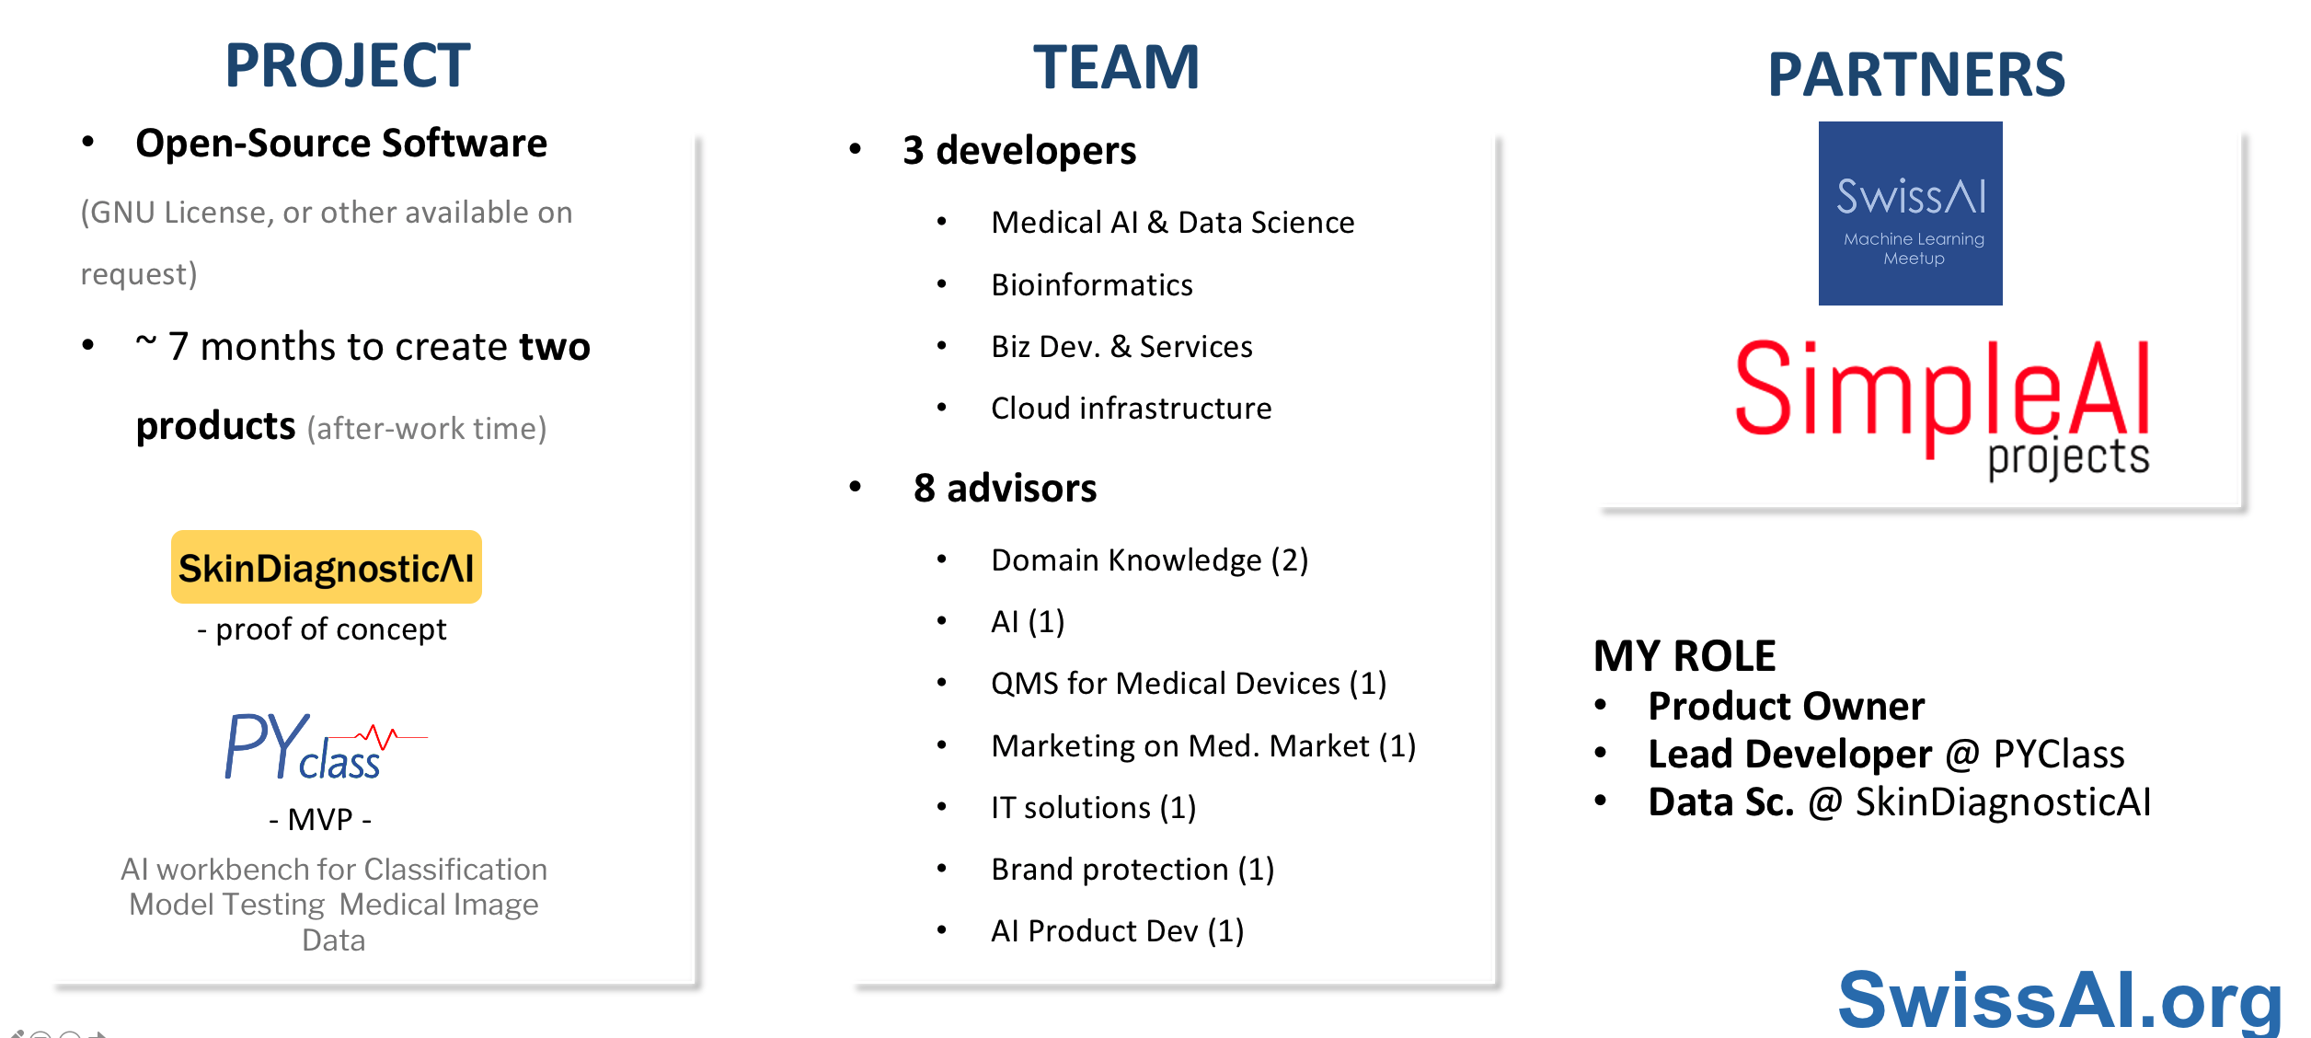
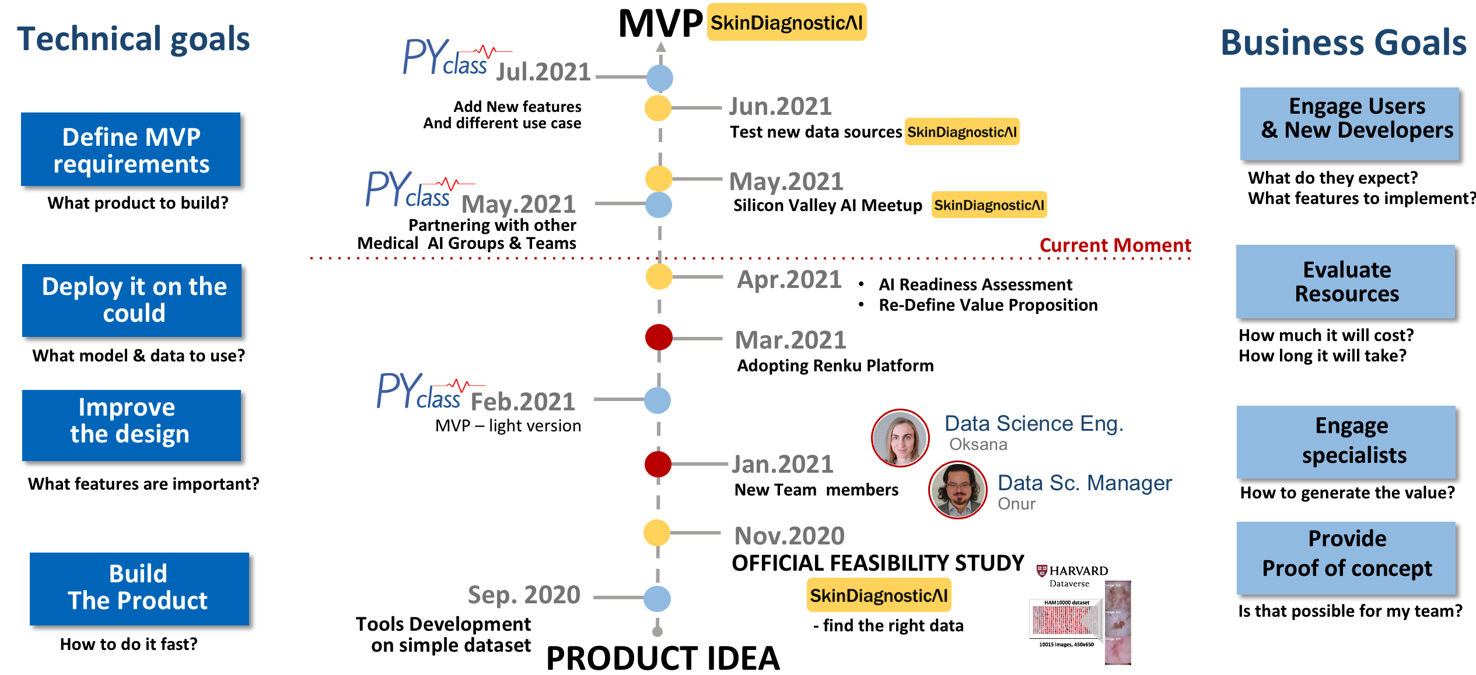
App for Skin Cancer Detection
with low-cost devices

Slide 8
App for Skin Cancer Detection
with low-cost devices
PRODUCT IDEA
App for Skin Cancer Detection with low-cost devices
FEASIBILITY STUDY

Slide 9
AI workbench for Analysis
of Medical Images
Easy interpretation
Visualize Trends & Examples
Medical Images classification

Slide 10
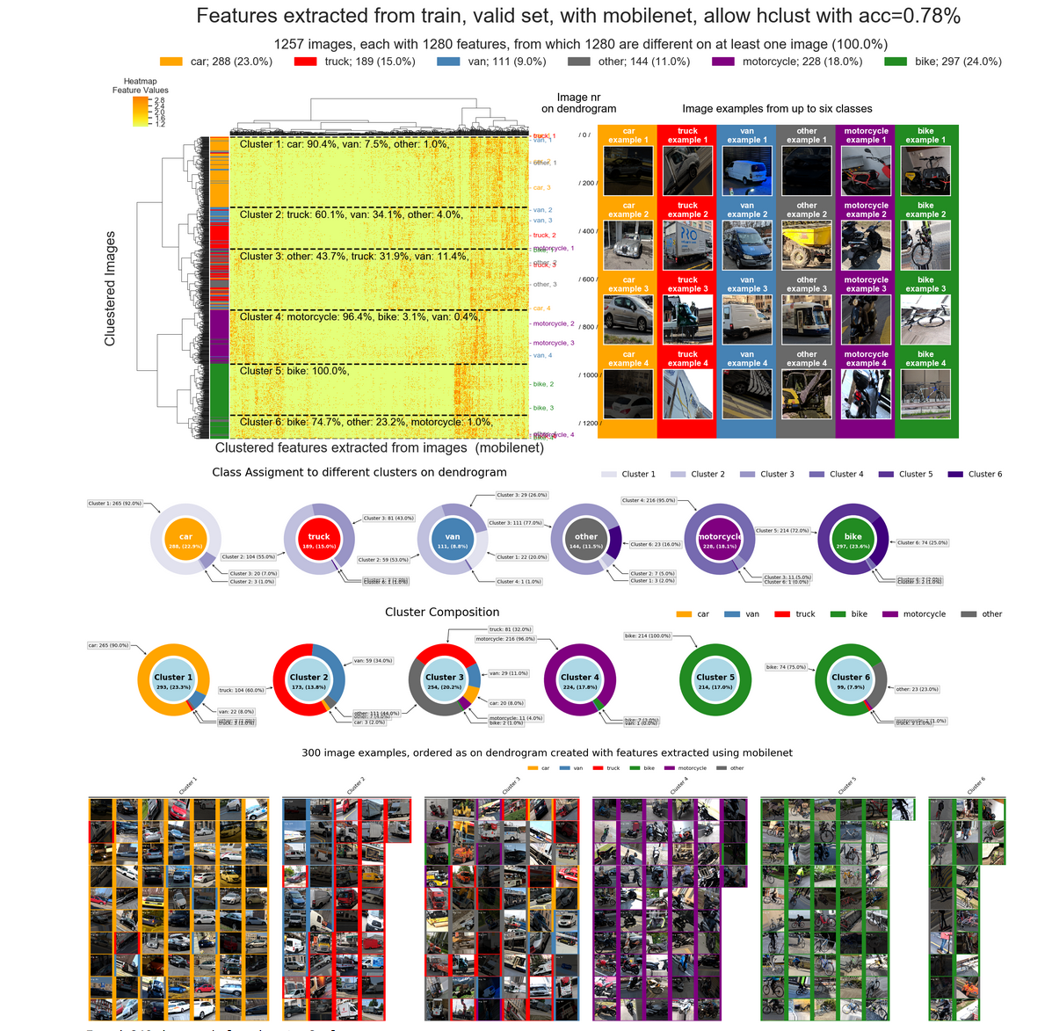
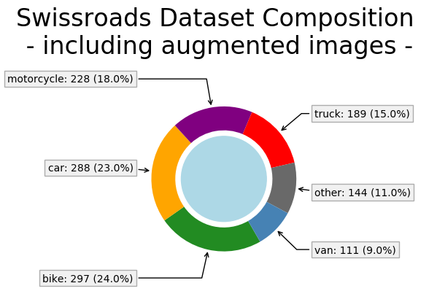
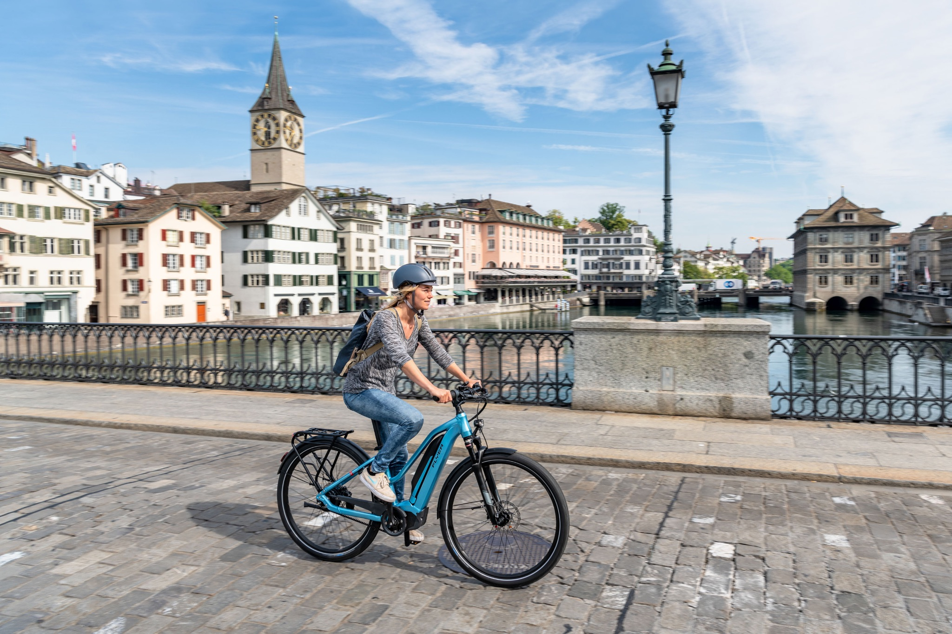
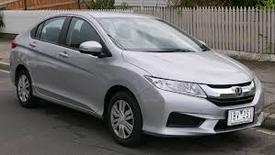
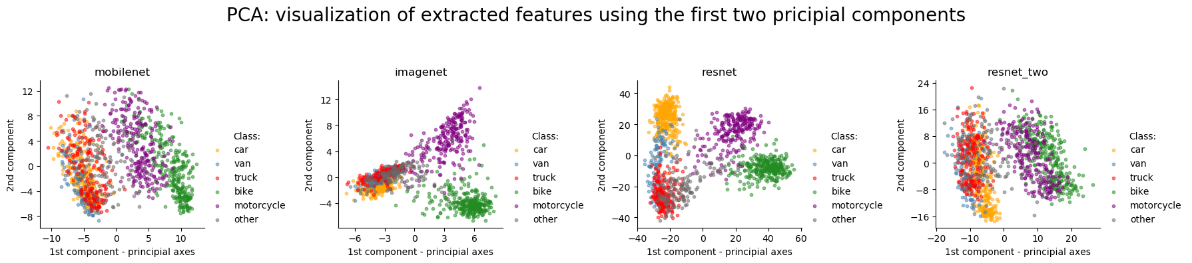
AI workbench for Analysis
of Medical Images

Slide 11
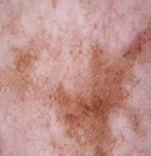
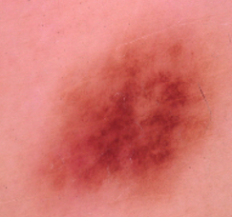
AI workbench for Analysis
of Medical Images

Slide 12
App for Skin Cancer Detection
with low-cost devices
App for Skin Cancer Detection with low-cost devices
PRODUCT IDEA

Slide 13
App for Skin Cancer Detection
with low-cost devices

Slide 14
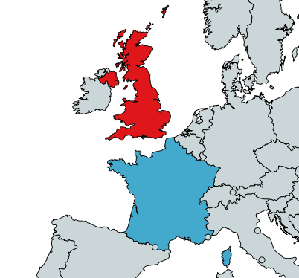
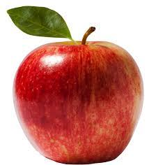

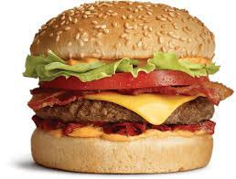
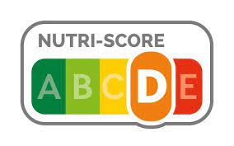
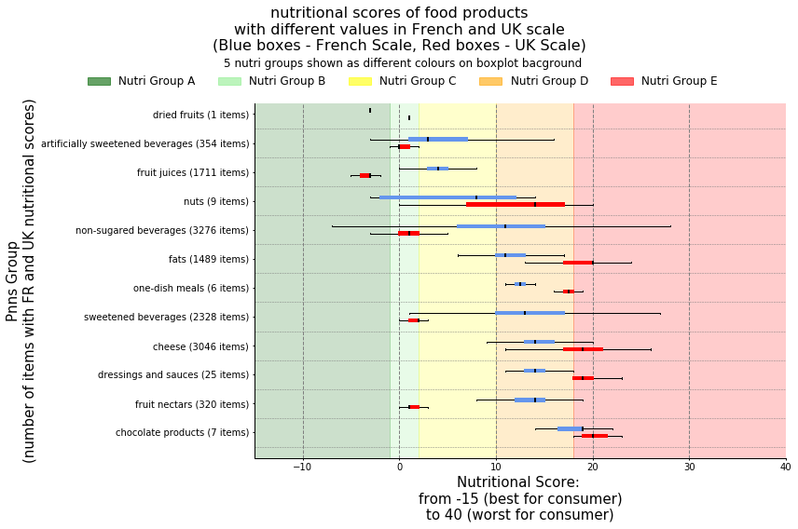

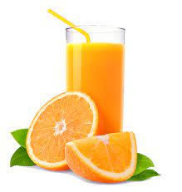
Can You Trust to Food Labels ?
UK
Nutri-Score Informs you how healthy is your food
France
Some countries, use different algorithms
Analysis of 330.000 food products
It reveled that products with different Nutri-scores belong to specific product groups that are consistently showed as more or less heathy in UK or France
Labelled as:
Heathier in France
Heathier in UK

Slide 15
Vehicle
classification
with

Slide 16
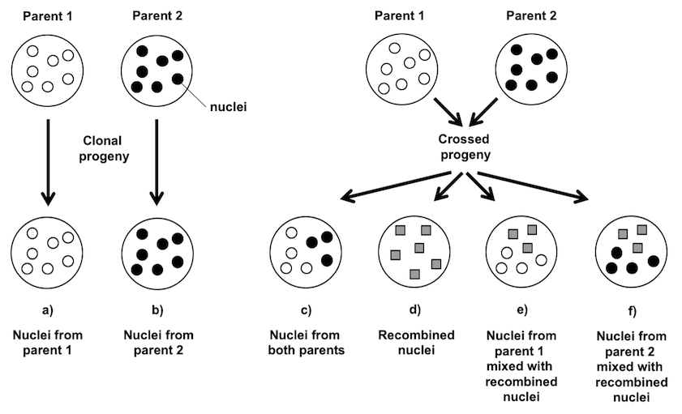
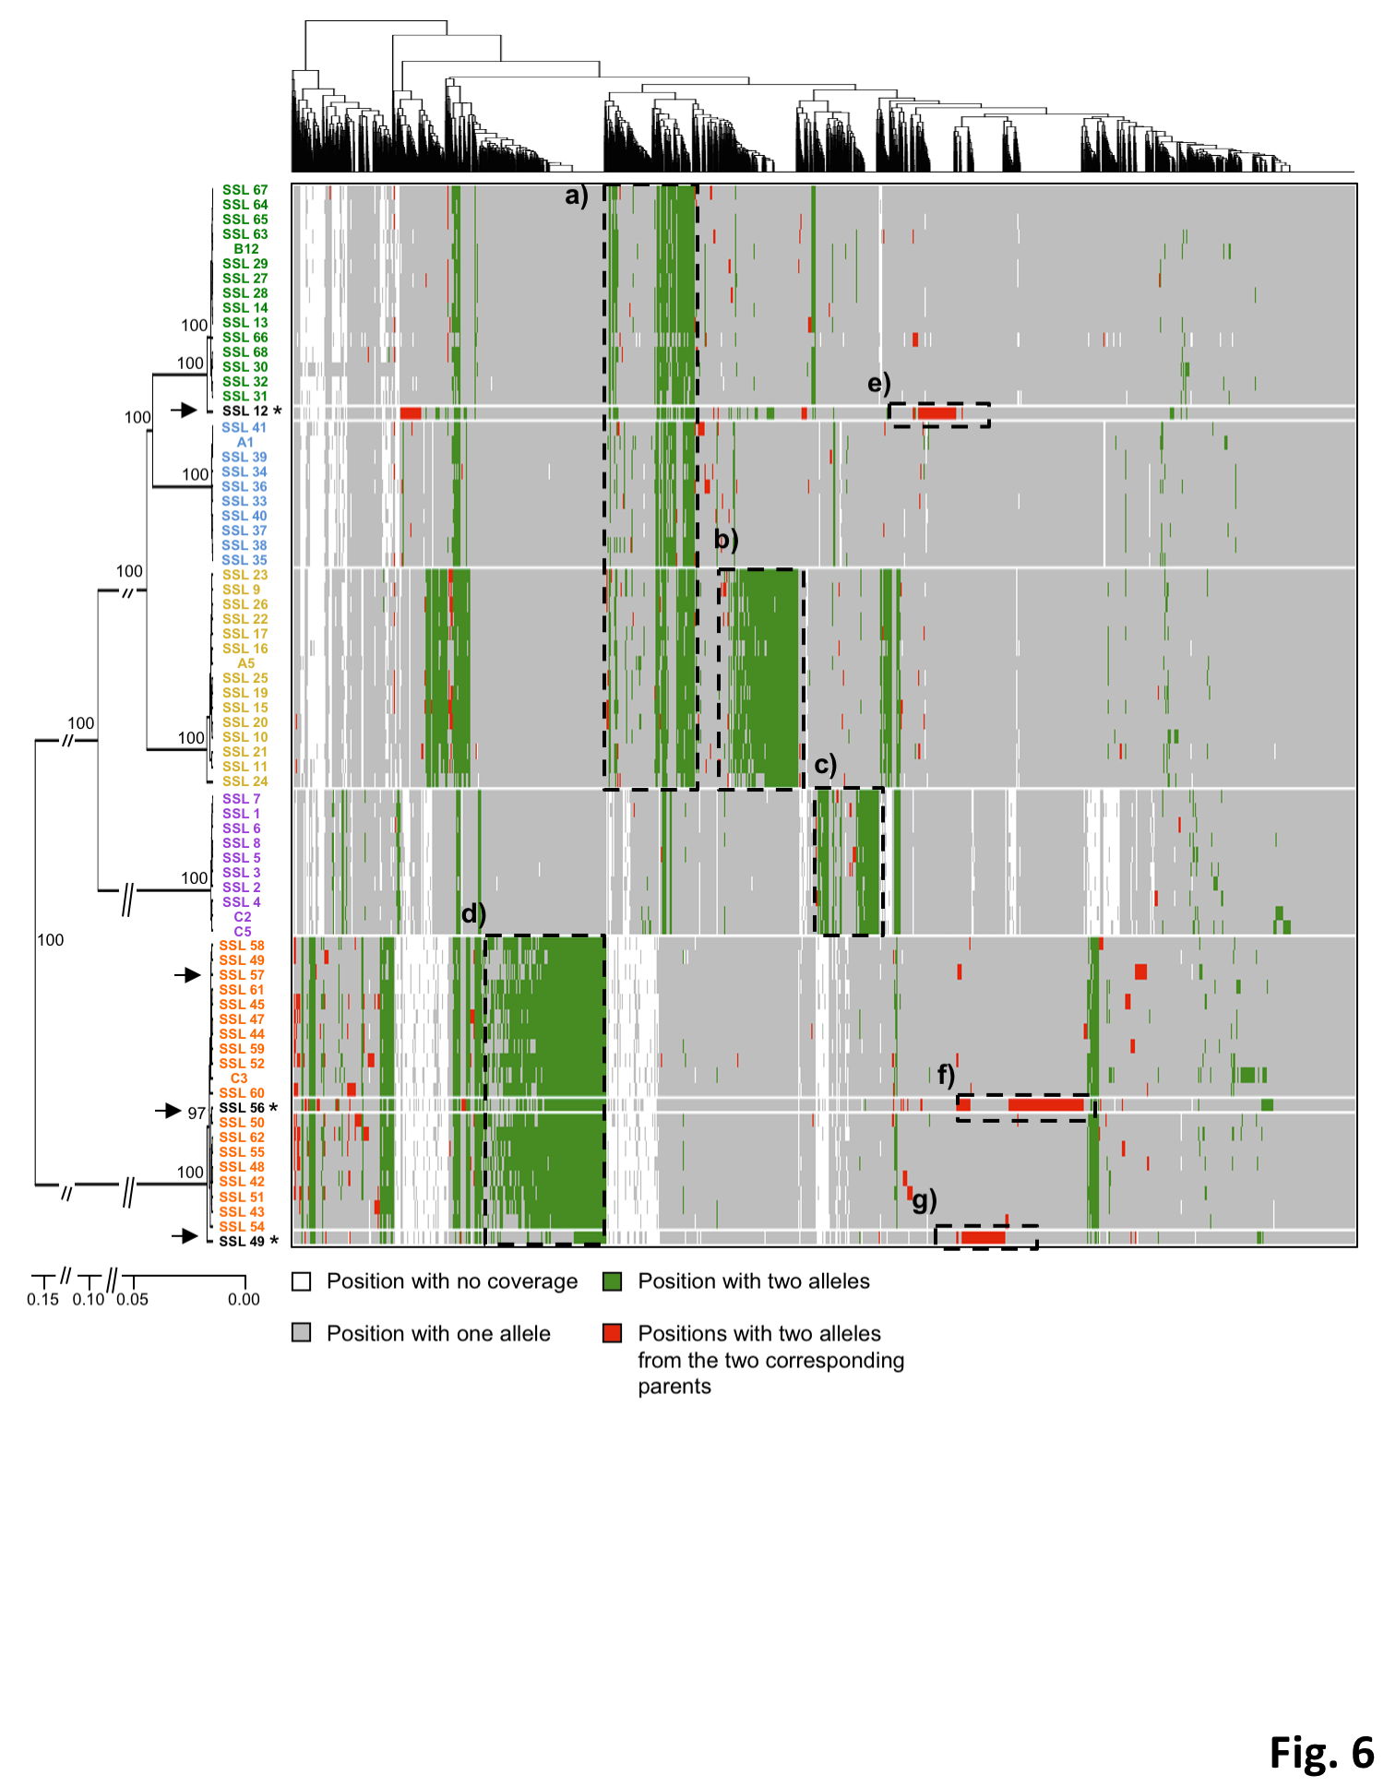
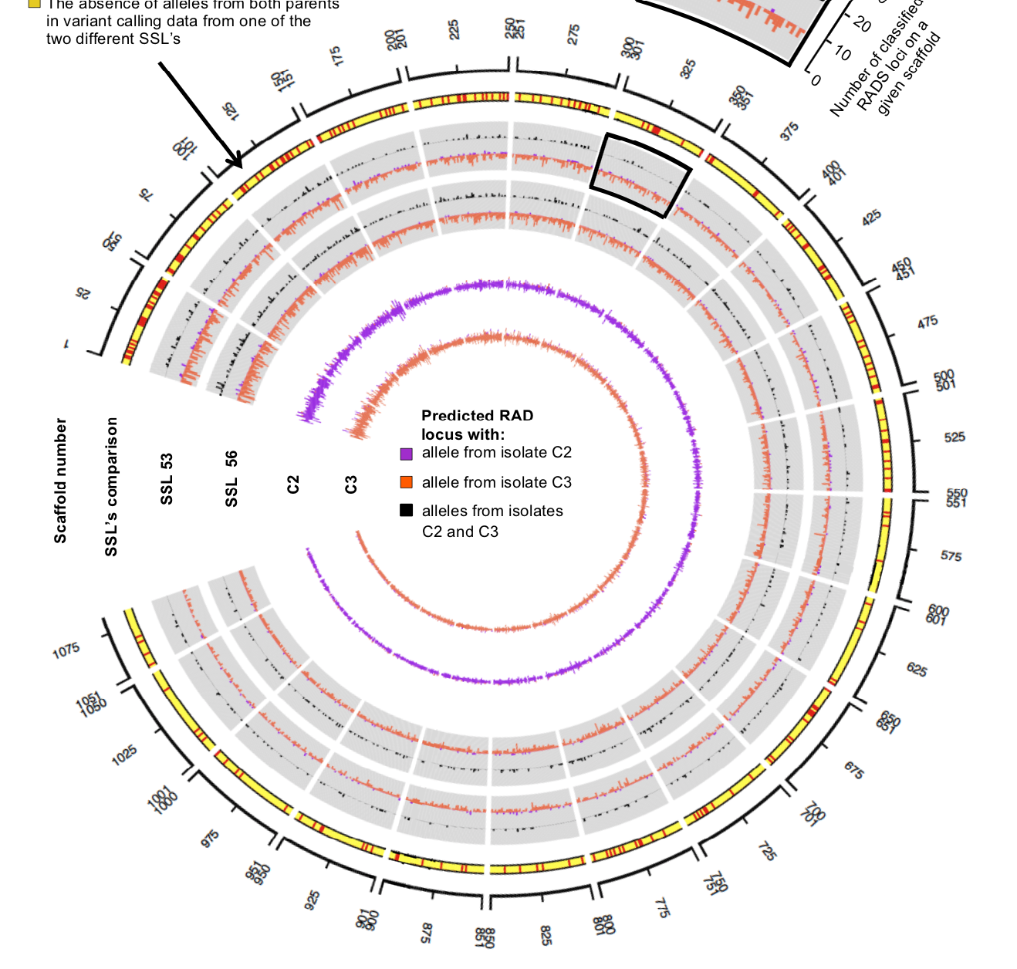
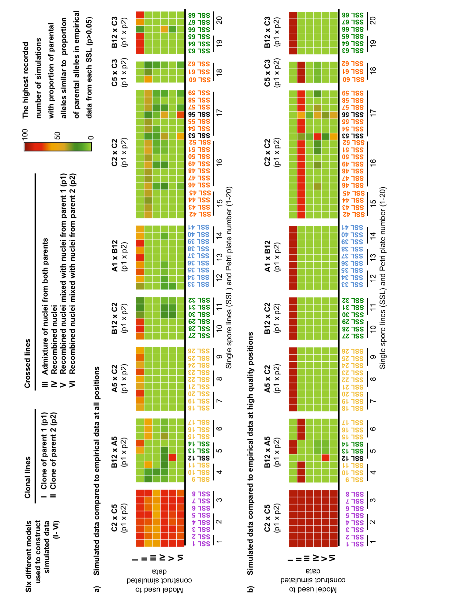
Production of new
Strains Biofertilizer
Fungi

Slide 17
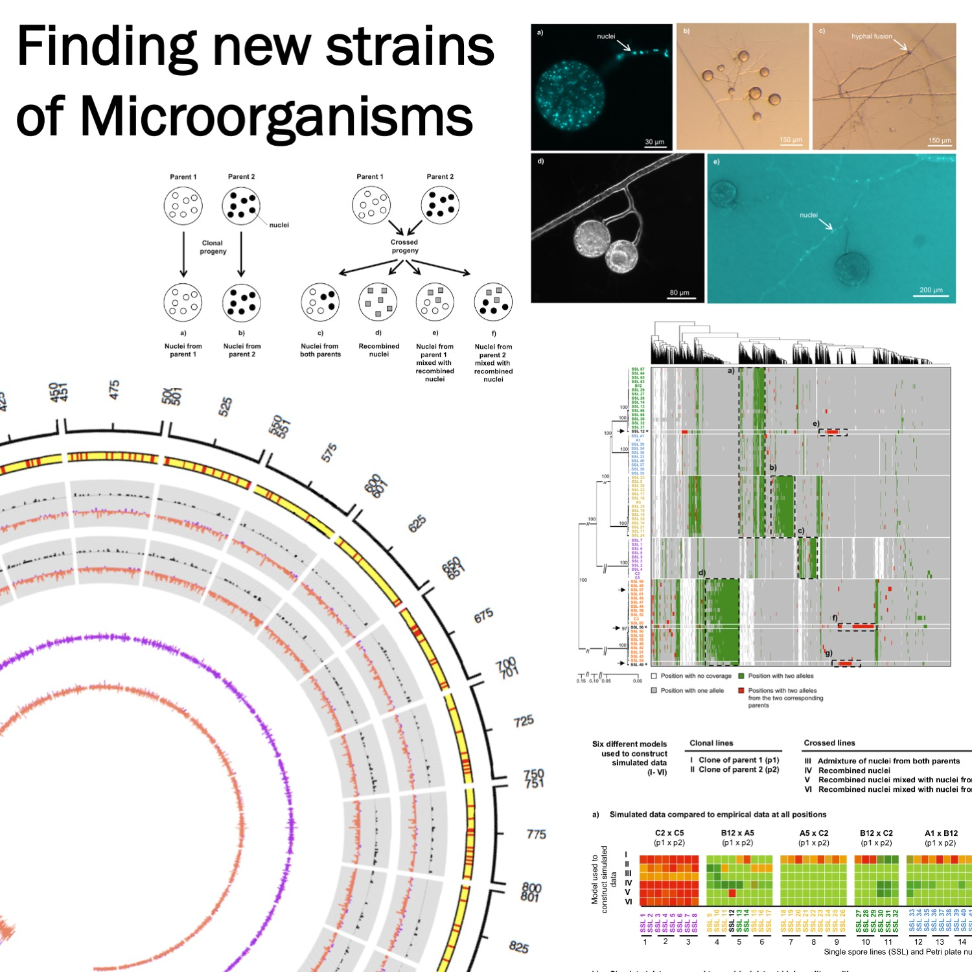
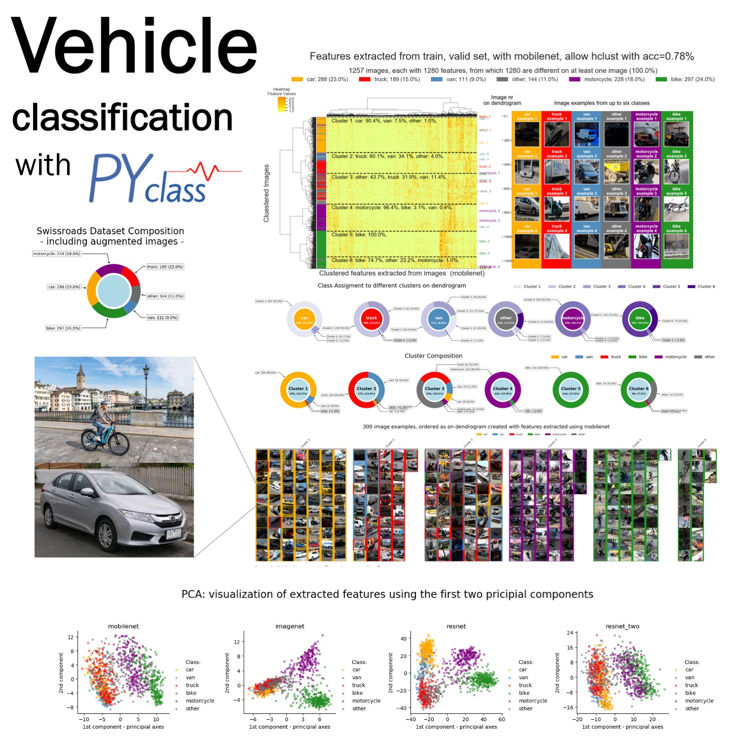
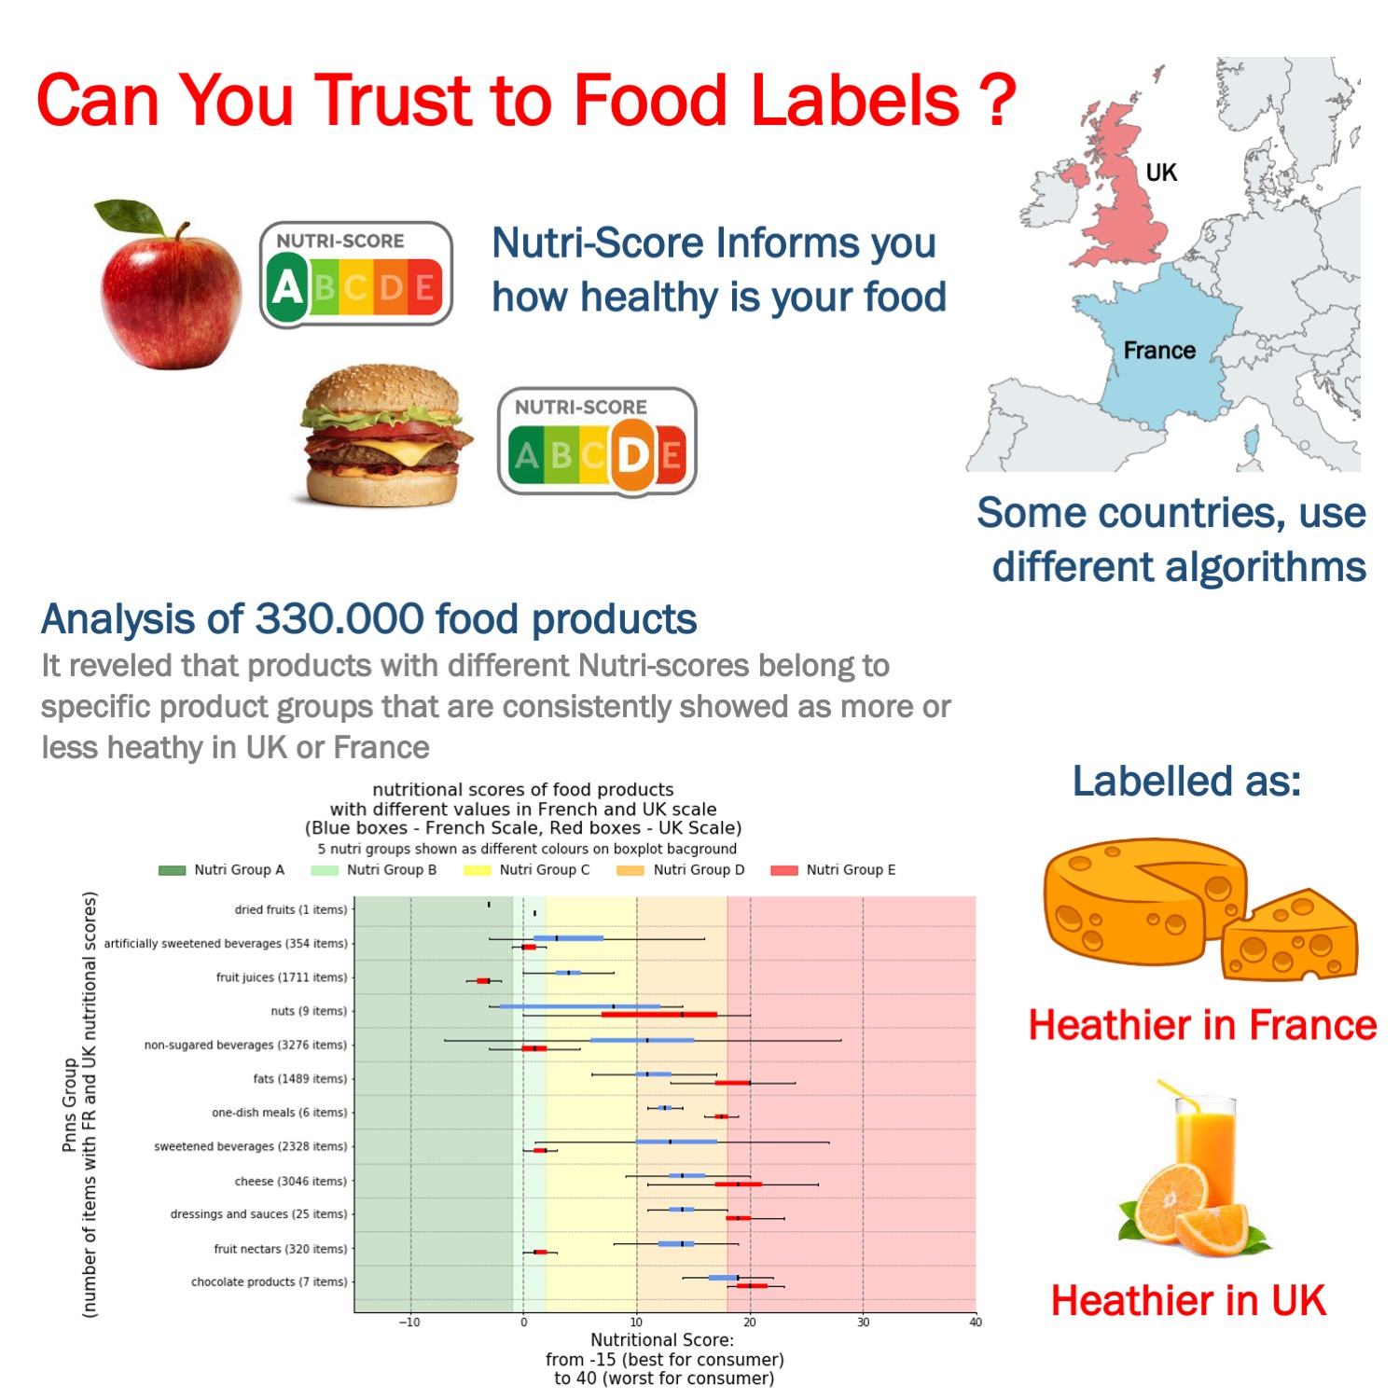


Slide 18




Slide 19
AI workbench for Analysis
of Medical Images

Slide 20


Easy interpretation
AI workbench for Analysis
of Medical Images
Visualize Trends & Examples
Evaluate Models
Easy Interpretation

Slide 21










Fast summary for hundreds
of features
Find Trends
... duplicates
and correlations

Slide 22



Patient
Control
Finds
reliable mutations in sequence data
Strain C3
Pooled
replicates
Strain C2
Pooled
replicates
Freebayes
2859
3.6%
Freebayes
2335
3.9%
32385
40.7%
25428
32.0%
6164
7.8%
25283
41.7%
19624
32.2%
3738
6.2%
9825
12.4%
1789
2.2%
7400
12.2%
1320
2.2%
1079
1.4%
903
1.5%
GATK
GATK

Slide 23
∙ almost 2500
members from:
∙ Meetups
∙ Courses
∙ Workshops

